Slide 1


COVID-19 Dataset Analysis
Sep,22
DIPANJAN MAITY
MOHIT NAKADE
REEMA SHARMA
VINEET BHARTI

Slide 2
Introduction
The Coronavirus Disease Pandemic of 2019 (COVID-19) serves as a timely reminder of the characteristics and consequences of public health emergencies of global relevance.
India had reported more than 5.28 Lakh deaths and over 4.45 crore cases as of September 12, 2022.
This study's goal is to examine the COVID-19 pandemic's variable manifestation in order to draw conclusions for an efficient public health emergency response.

Slide 3
Method
Data Collection
We collected different JSON file from data.covid19india.org. These JSON files contains numbers across Confirmed, Recovered, Deceased per states and districts.
Data Manipulation and Cleaning
We built a csv file by extracting the necessary data from JSON files using Python
Data Aggregation
We removed unnecessary columns and dealt with missing values
To extract the necessary data and perform various forms of aggregation, we used MS SQL.
Dashboard Creation
We used all the data we gathered to construct an interactive dashboard in MS Excel and presented all of our insights.

Slide 4
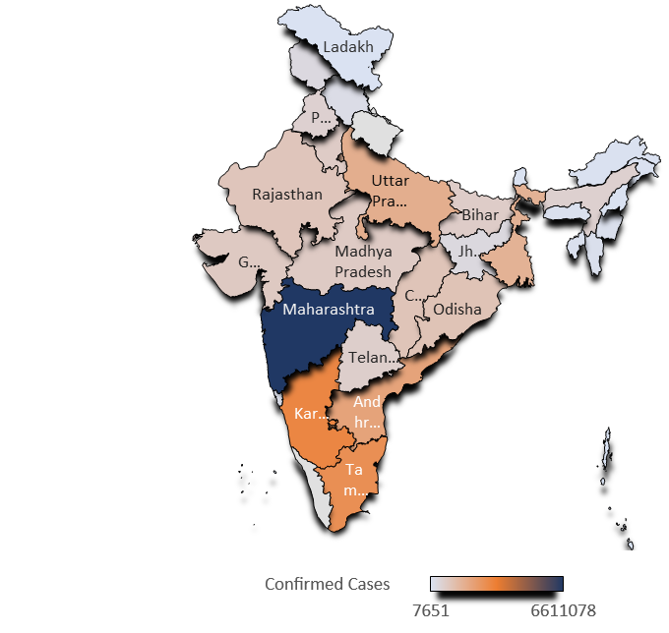
State-wise Confirmed Cases:
Top 10 states in terms of total number of Confirmed cases (in Millions) :
Maharashtra: 6.6M
Kerala: 4.9M
Karnataka: 2.9M
Tamil Nadu: 2.7M
Andhra Pradesh: 2.0M
Uttar Pradesh: 1.7M
West Bengal: 1.5M
Delhi: 1.4M
Orissa: 1.0M
Chhattisgarh: 1.0M

Slide 5

State-wise Recovered Cases:
Top 10 states in terms of total number of Recovered cases (in Millions) :
Maharashtra 6.4M
Kerala 4.8M
Karnataka 2.9M
Tamil Nadu 2.6M
Andhra Pradesh 2.0M
Uttar Pradesh 1.6M
West Bengal 1.5M
Delhi 1.4M
Orissa 1.0M
Chhattisgarh 9.9M

Slide 6
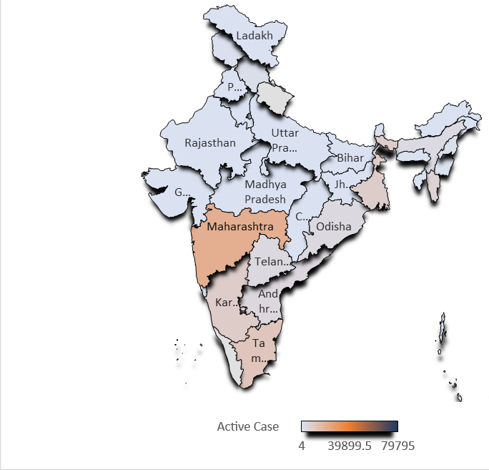
State-wise Active Cases:
Top 10 states in terms of total number of Active cases :
Kerala 79795
Maharashtra 20277
Tamil Nadu 11492
Karnataka 8673
"West Bengal" 8296
Mizoram 6315
"Andhra Pradesh" 4355
Telangana 4009
Orissa 3924
Assam 3674

Slide 7
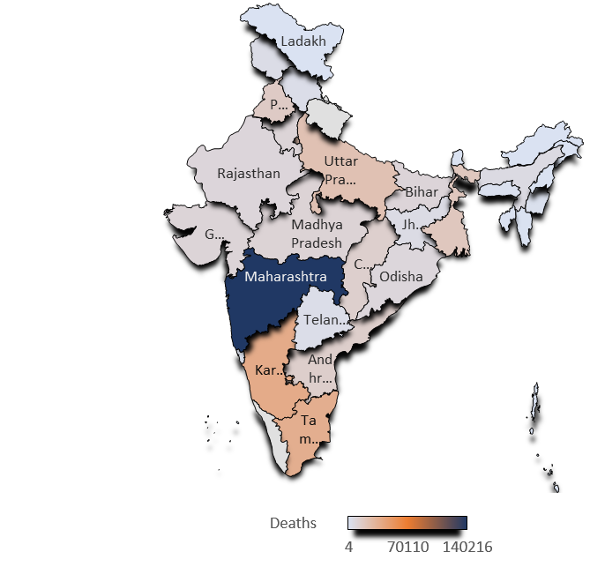
State-wise Death Count:
Top 10 states in terms of total number of Deaths:
Maharashtra 140216
Karnataka 38082
Tamil Nadu 36116
Kerala 31681
Delhi 25091
Uttar Pradesh 22900
West Bengal 19141
Punjab 16559
Andhra Pradesh 14373
Chhattisgarh 13577

Slide 8
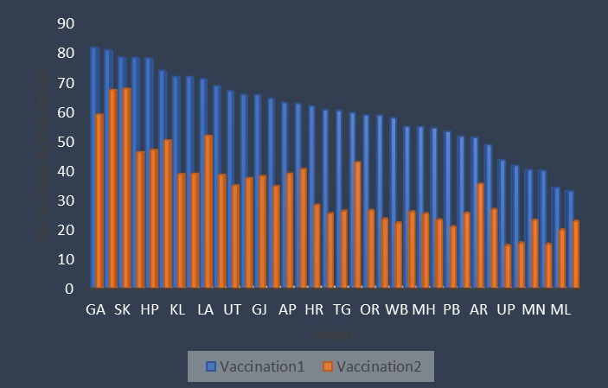
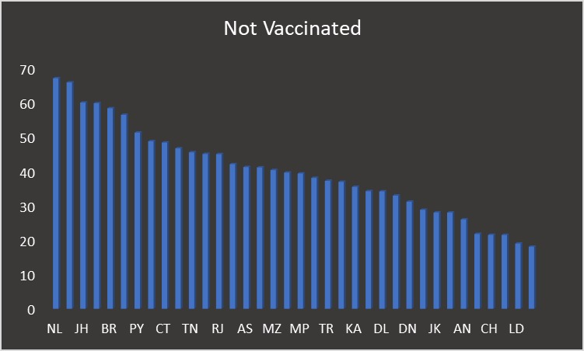
State-wise Vaccination Count:
Top performing State in terms of Vaccination:
Sate | Dose | Vaccination Percentage (out of Total State Population)
Goa | 1st Dose | 81.98 %
Sikkim | 2nd Dose | 68 %
Lowest Performing State in terms of Vaccination:
State | Not Vaccinated % (out of Total State Population)
Nagaland | 67%
Meghalaya | 65%
Chhattisgarh ,Himachal Pradesh, Jammu Kashmir, Kerala were the states where first vaccination dose was greater than 70% and Second Vaccination Dose was less than 50%. So in these states Govt should takes some initiatives to promote importance of second Vaccination.

Slide 9
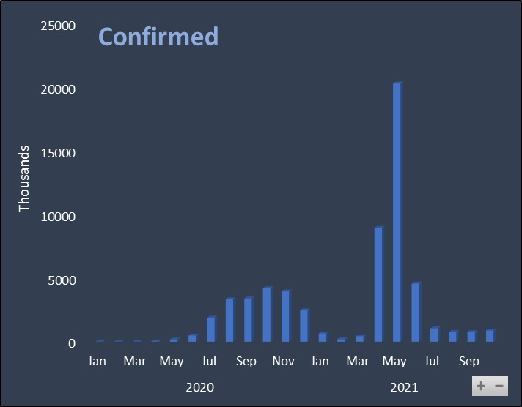
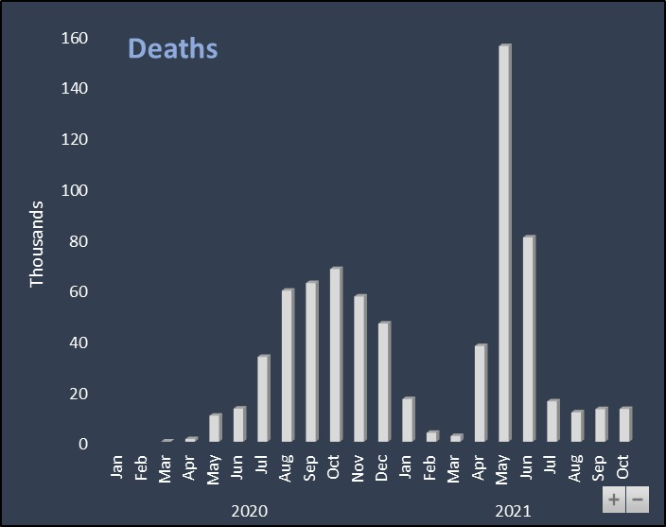
Month-wise Confirmed and Death Analysis:
Year wise top month in terms of total number of Confirmed cases :
May,2021 : 20276407
October,2020 : 4198140
Year wise top months in terms of total number of Death Count :
May,2021 : 155289
October,2020 : 67788

Slide 10
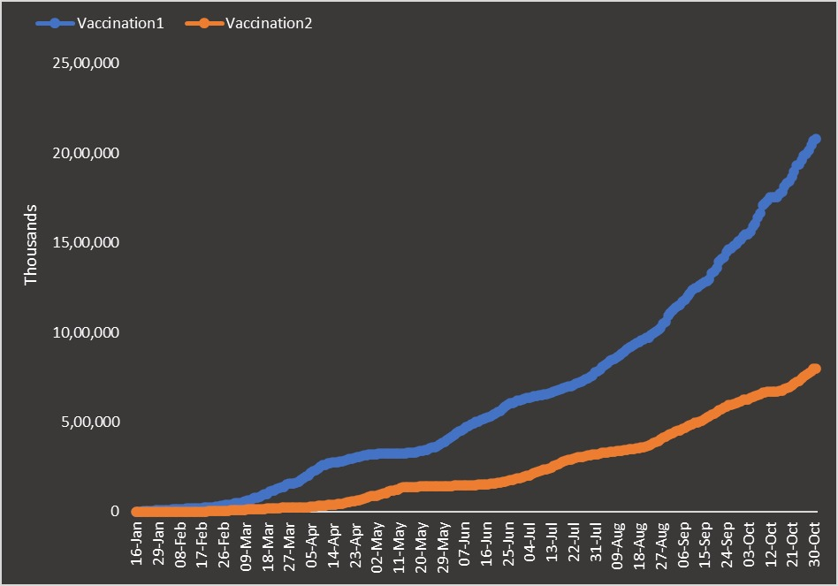
Month-wise Vaccination Analysis:
Vaccination Started : 16 January 2021
Total Vaccination (1st Dose) : 559055089
Total Vaccination ( 2nd Dose) : 180449555
Here, we can see that people participated in first vaccination very actively but in case of second dose of vaccination there is a huge drop in numbers due to lack of interest and awareness among people.

Slide 11
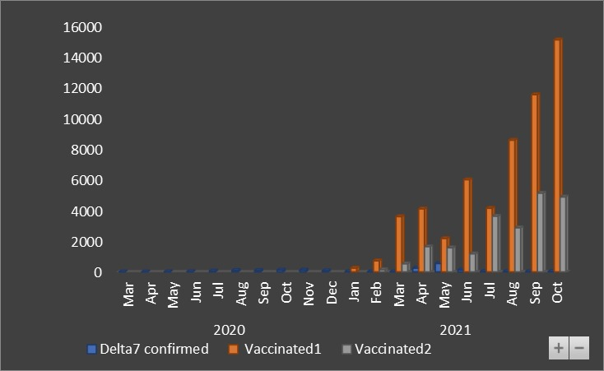
Month-wise Delta7 Analysis:
Delta7 confirmed cases with respect to vaccination
Observation:
Here we can see that after the vaccination drive started, the Number of vaccination done per month is greater than the number of confirmed cases per month.

Slide 12
Test Ratio Analysis:
testing ratio(tr) = (number of tests done) / (population)
Here we categorize every district in one of the following categories:
Category A: 0 ≤ tr ≤ 0.1
Category B: 0.1 < tr ≤ 0.3
Category C: 0.3 < tr ≤ 0.5
Category D: 0.5 < tr ≤ 0.75
Category E: 0.75 < tr ≤ 1.0
Category F : tr>1
Then we perform an analysis of number of % of deaths across all category.
Category Number_of_District Avg Testing Ratio Percentage_decesed
Category_F 9 2.10 0.106044244
Category_D 2 0.73 0.123740936
Category_C 16 0.38 0.06633278
Category_B 232 0.16 0.027178038
Category_A 287 0.03 0.029220981

Slide 13
Thank You

